Slide 1
SG8002 Lesson 4: Process, making Eye Contact, Signposting & Chunking
Semester A 2021-2022

Slide 2
Last Lesson
This Lesson
Quick revision of Word Stress
Revision of Teaching Strategy 1: Definition and Classification
Revision of Presentation Skills: smiling, stress, hand gestures and signposting
Introduction to Sentence Stress, Rhythm and intonation
Introduction to chunking
Teaching Strategy 2: Comparison and Contrast
Teach a 3-minute Compare and Contrast mini-lesson
Homework explanation
Any questions?
Quick revision of Sentence Stress, Rhythm and Intonation
Teaching Strategy 3: Process
Speaking and Listening activities for Process
More practice with Chunking while making Eye Contact
More Signposting vocabulary for different presentation functions
Prepare and teach a 4-minute Process mini-lesson
Discuss Week 6 Assessment requirements, schedule, tips and receive assessment package
Homework explanation

Slide 3


Slide 4
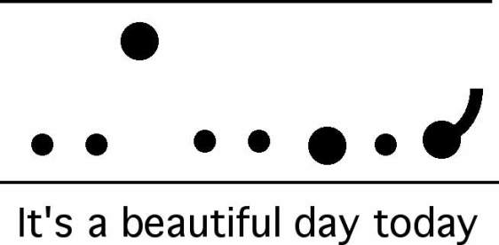
Prosodic features: Sentence Stress, Rhythm and Intonation

Slide 5

Sentence Stress & Rhythm
Look at the following sentences. Which words should you stress? Say the sentences and snap your fingers on the stressed words with a regular beat.
He’s been offered a job.
We’re sorry we’re late. We’ve been at a party.
I haven’t heard from Tom for a while.
I’m sure he could have found a better one than that.

Slide 6

Sentence Stress & Rhythm
Practise saying the following text with accurate sentence stress.
I don’t need to stress every word when I speak. I only need to pronounce the key words right to get my meaning across. What I don’t emphasize becomes much shorter, quicker, and quieter. Already, I can begin to feel I’m speaking English better.

Slide 7

Stress and rhythm, and intonation
Stress and Rhythm
The most important words in a sentence are stressed - (nouns, verbs, adjectives, adverbs)
Sentence stress provides the rhythm of a sentence

Slide 8
Contrastive Stress
Practise the following dialogues with a partner. Think about where to put the stress.
1. | You live in Kowloon Tong, don’t you? No I work in Kowloon Tong.
2. | Are you Japanese? No, I’m Chinese.
3. | Your address is Flat 2B, 36 Nathan Road, right? No, it’s Flat 2C, 236 Nathan Road.
4. | Your address is Flat 2B, 36 Nathan Road, right? No, it’s Flat 2B, 56 Nathan Road.

Slide 9
Contrastive Stress
Practise the reading the following conversation two times with a partner. (One time you
are Dave and one time you are Andy.) Be sure to fully stress the highlighted words.
Dave: I bought a really interesting book last week.
Andy: Last night?
Dave: No, last week. It’s about climate change.
Andy: Who wrote it?
Dave: Al Gore.
Andy: Oh, she’s great.
Dave: You mean he, don’t you?
Andy: Oh. Sorry. What does he say?
Dave: He says climate change is your fault!
Andy: My fault?!
Dave: Well, you do drive a big car, don’t you?
Andy: Don’t you?
Dave: No, I sold mine.
Andy: Well, I’ll never sell mine. It’s too comfortable.
Dave: Maybe you think that’s important, But I think the environment is more important.
Andy: The environment is important. But if you ask me, comfort is the most important.
Dave: You’re terrible!
Andy: No, you are!

Slide 10

Intonation
Intonation is the rising or falling tone at the end of a sentence or question.

Slide 11
Stress and rhythm, and intonation
Listen to the stress, rhythm, and intonation of this limerick.
Now you try it.
My name is Yon Yonson,
I come from Wisconsin
I work in a lumber yard there
Everyone that I meet
When I walk down the street
Says Hello What's your name?
And I say … (pause)
My name is Yon Yonson
(repeat again and again)

Slide 12


Slide 13

Limericks: (5-line poems with rhythm)
Try reading this aloud with appropriate word stress, rhythm and intonation.
There was an odd fellow named Gus When travelling he made such a fuss He was banned from the train Not allowed on a plane And now travels only by bus.

Slide 14
Limericks: (5-line poems with rhythm)
Try reading this aloud with appropriate word stress, rhythm and intonation.
My neighbor came over to say Although not in a neighborly way That he'd knock me around If I didn't stop the sound Of the rock n’ roll music I play

Slide 15
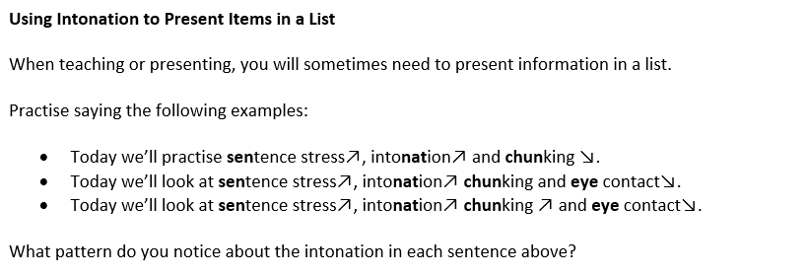
Activity: Complete the rule about intonation when presenting lists:
When presenting a list in English, all items in the list will have rising intonation except the ________ one, which will ________.

Slide 16
Make lists of the following. Make sure there are the correct number of items in each list.
 | Your lists
Items you need to buy (3 items)
Countries you hope to visit (4 items)
Things you must do this week (5 items)
Practise presenting the items in your lists with appropriate stress and intonation. (Be prepared to present your lists to the class with proper intonation according to the rule about presenting items in a list.)

Slide 17
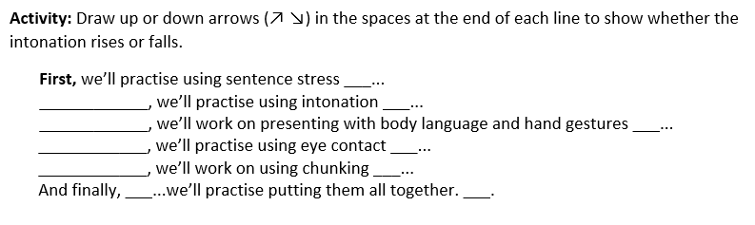
Using Intonation when presenting lists
First Then Next After that

Slide 18
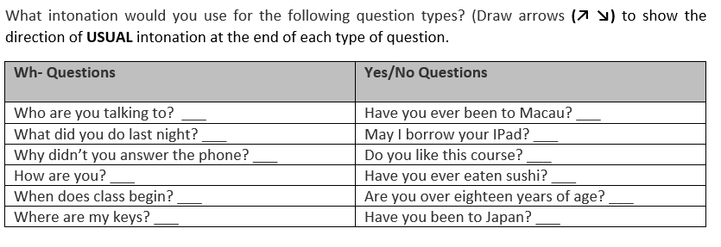
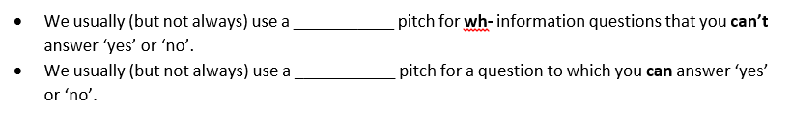
Intonation in Questions

Slide 19
Intonation
Use up or down arrows (↗ ↘) to mark the appropriate intonation at the end of the following questions.
‘So why give an oral presentation ___? Why not simply provide a report ___? Why not simply write a paper ___? Is there something which an oral presentation can do which a written report cannot ___? ‘

Slide 20

Presentation Technique: Chunking
Presenting information to an audience is similar to feeding a baby. It should be done gradually so that the ‘food’, or information, is received comfortably. If information is given too quickly, the audience cannot ‘digest’ it easily, which may cause confusion or problems in understanding what you are talking about. Using chunking in your presentation can prevent this problem.
Look at the following famous line from William Shakespeare’s play, Hamlet.
‘To be or not to be; that is the question.’
Where would you naturally pause when delivering this sentence?

Slide 21
Chunking
Try these possible ways to say this sentence with chunking:
-‘To be / or not to be; / that / is the question.’
-‘To be / or not to be; / that is the question.’
-‘To be / or not / to be; / that / is the question.’
Which one feels most comfortable to you?

Slide 22

Chunking
Decide where the pauses [ / ] should be.
Decide which word in each chunk should be stressed.
Use appropriate intonation.
Possible ways:
-"Two wrongs / don't / make a right.“
-"The pen / is mightier / than the sword.“
-"When in Rome / do / as the Romans do.“
-"People who live / in glass houses / should not / throw stones."

Slide 23
Chunking
Chunking means saying words in groups, not individually. Saying each word individually sounds unnatural.
Instead, chunks of words should be spoken with natural stress and intonation, and with a pause after each chunk.

Slide 24


Practise the first part of the CPI video from last week with a partner!
‘CPI is defined / by the Bureau of Labor Statistics / as a measure / of the average change over time / in the prices paid by urban consumers / for a market basket / of consumer goods and services. / Now, / what does that mean? / That means, / that it measures how much, / more or less, / you pay for things you buy / as an urban consumer.’

Slide 25
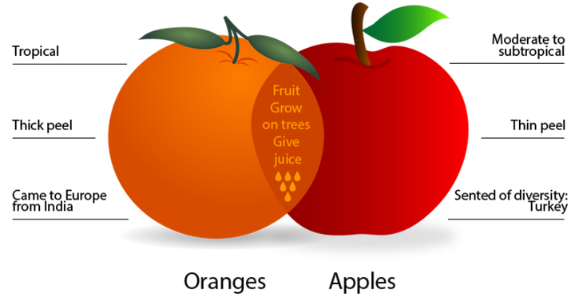
Teaching Strategy 2:
Comparison and Contrast

Slide 26

Quick Compare and Contrast Speaking Activity
Choose 2 or 3 of the following and compare and contrast them with your partner. Then switch roles.
Pens vs pencils
Piano vs guitar
Shopping in stores vs online shopping
Cantonese vs Sichuan food
Tea vs coffee

Slide 27
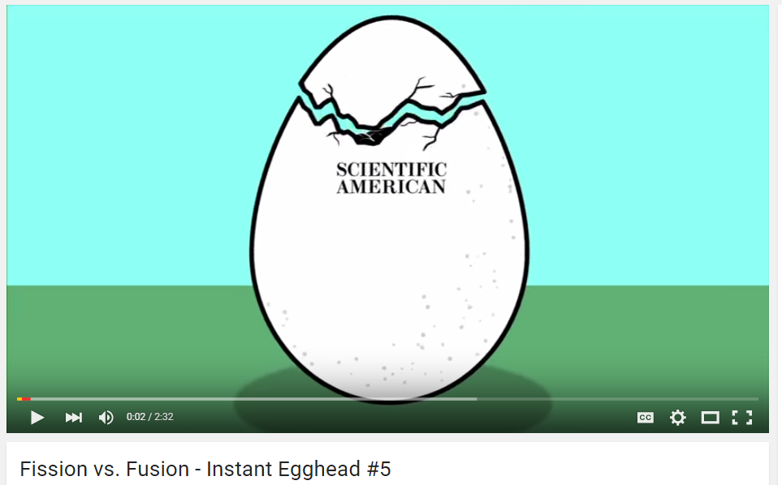
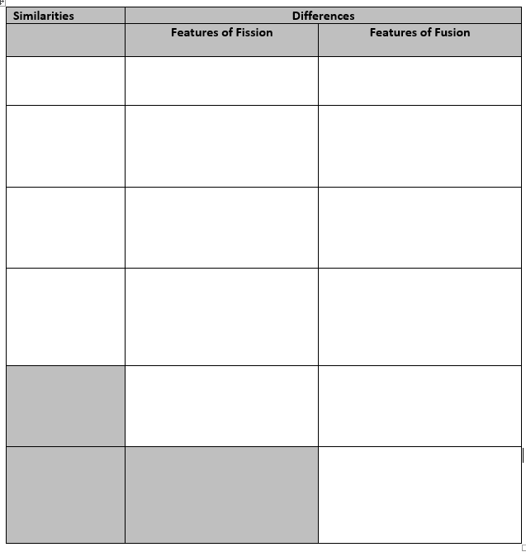
While listening to the video about fission and fusion, fill out the similarities and differences in the chart below:
https://www.youtube.com/watch?v=3rn339v_Q-w

Slide 28
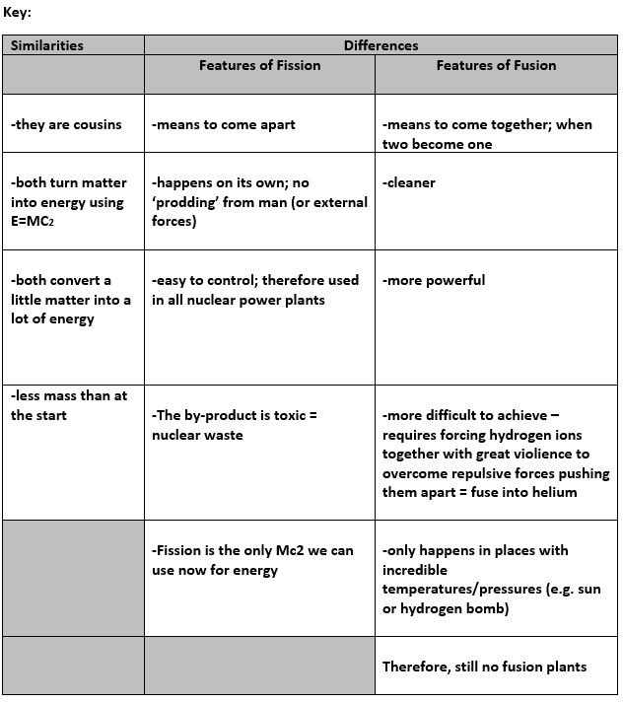

Slide 29
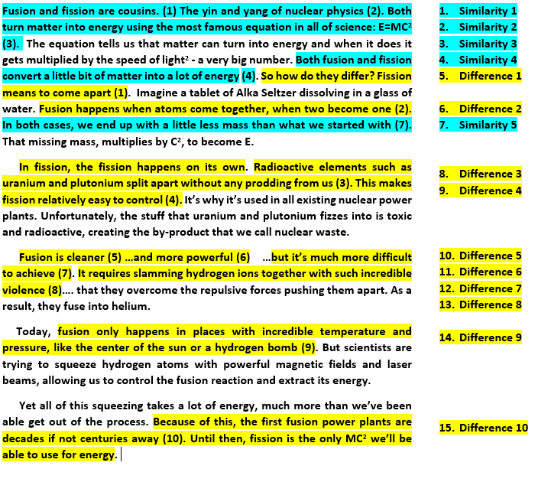
Notice the structure of this ‘Compare and Contrast’ lesson
https://www.youtube.com/watch?v=3rn339v_Q-w

Slide 30
Chunking
One possibility:
Fusion / and fission / are cousins. / The yin and yang / of nuclear physics. / Both / turn matter into energy / using the most famous equation / in all of science: / E=MC². / The equation / tells us / that matter / can turn into energy / and when it does / it gets multiplied / by the speed of light² / - a very big number.

Slide 31
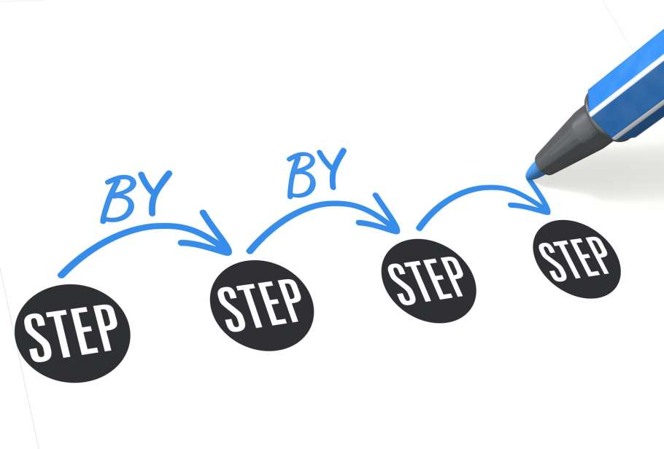
Teaching Strategy 3:
Process

Slide 32


Intended Learning Outcomes
By the end of today’s lesson, you should be able to:
a. understand what a process is and why it is important in teaching
b. give ‘live’ step by step instructions with a partner in English
on how to make a simple generator
c. identify common processes in different fields
d. use signposting when introducing different steps in a process
e. identify and apply active and passive voice when giving step
by step instructions
f. apply chunking to a process lesson
g. prepare a 4- minute lesson using proper pronunciation, word
and sentence stress, rhythm and intonation
h. use effective presentation delivery techniques, including smiling, word and
sentence stress, hand gestures and signposting

Slide 33
process
A process is a sequence of events. When talking about a process, it is important to show sequence.
Sequence occurs over time, so the language that you use to talk about the sequence of events in a process should indicate or imply that time is passing.
Stages may follow each other and in each stage a certain action can take place. Furthermore, in some stages, more than one action may take place.

Slide 34
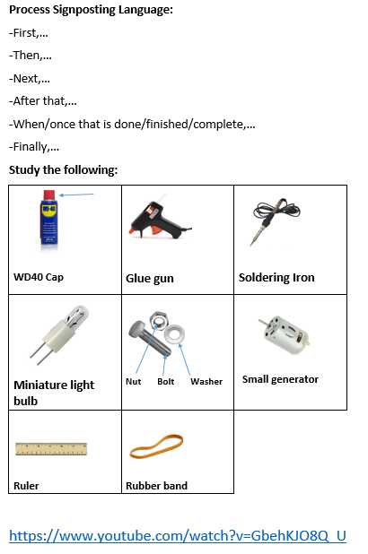

Slide 35
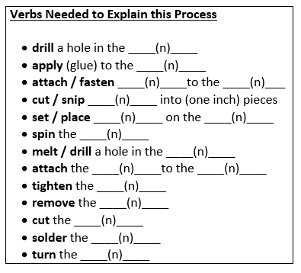
Now study the verbs you will need:

Slide 36
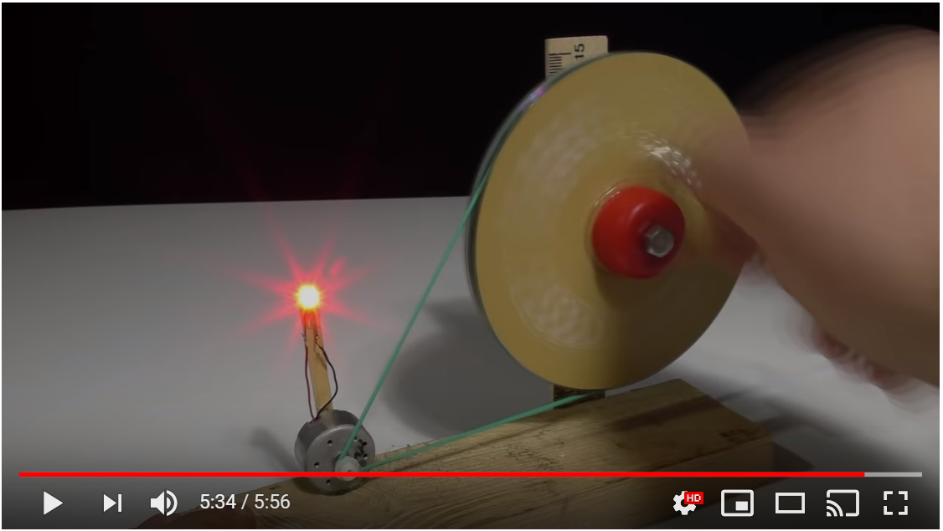
First Viewing: Just Watch the video
https://www.youtube.com/watch?v=GbehKJO8Q_U

Slide 37
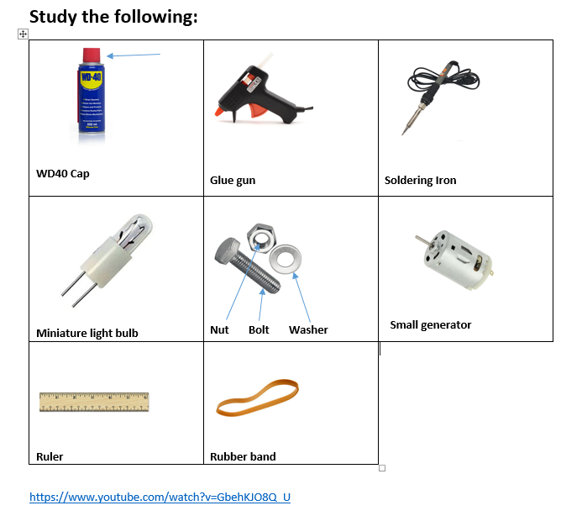
Second viewing: Explain all steps of the process
Now, with a partner, take turns describing each step of the process ‘live’ while the video plays a second time using the vocabulary (nouns and verbs) you studied (below) and any other vocabulary you may need…
Remember to use signposting to introduce each step of the process :
First,… Then…, After that,… When that is done,… Next,… Finally,…
https://www.youtube.com/watch?v=GbehKJO8Q_U

Slide 38
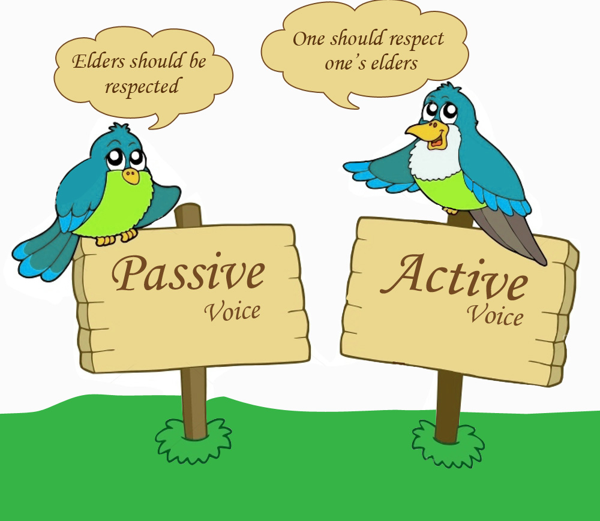
Notice the Active Voice in this Activity
Examples:
First, (you) drill a hole in the ruler.
Then, (you) apply glue to the ruler.
After that, (you) attach the ruler to the wood.
Finally, (you) spin the CDs to generate light.
In active voice, the emphasis is on the person doing the action.

Slide 39
Guess the task
This task is usually carried out several times a day. The process is simple but time consuming and often interferes with other more enjoyable activities. The items are first collected and sorted. Small pieces are usually dealt with first and larger items are left until the end. The degree of difficulty of the task depends on the facilities available, and the length of time since the items were last processed. If the facilities are very basic, then each item must be handled separately in two stages. If sophisticated equipment is available, then the process simply consists of transferring the items to a machine, which needs to be unloaded when the process is complete.

Slide 40
Notice the Passive Voice in this Activity
This task is usually carried out several times a day. The process is simple but time consuming and often interferes with other more enjoyable activities. The items are first collected and sorted. Small pieces are usually dealt with first and larger items are left until the end. The degree of difficulty of the task depends on the facilities available, and the length of time since the items were last processed. If the facilities are very basic, then each item must be handled separately in two stages. If sophisticated equipment is available, then the process simply consists of transferring the items to a machine, which needs to be unloaded when the process is complete.

Slide 41
Notice the Passive Voice in this Activity
Examples:
This task is usually carried out several times a day.
The items are first collected and sorted. After that, (you) attach the ruler to the wood.
Small pieces are usually dealt with first and larger items are left until the end.
In passive voice, the emphasis is on the action being done.

Slide 42

Your Turn!
Think of a very simple daily process. Keep it secret. When you and your partner are ready, describe your processes to each other. Your partner will guess the process you are describing.
Tip!
You may use active or passive voice.

Slide 43
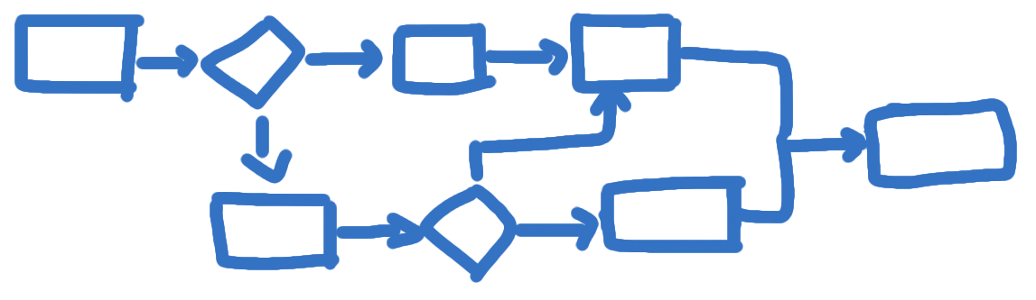
Some commonly found processes

Slide 44
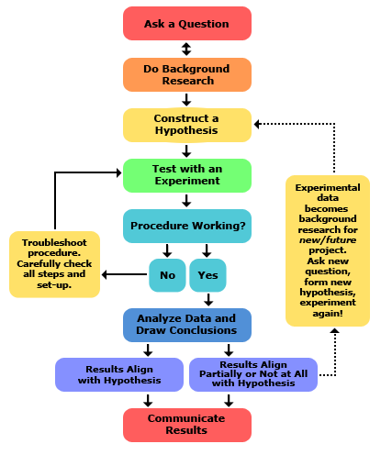
Scientific Process

Slide 45
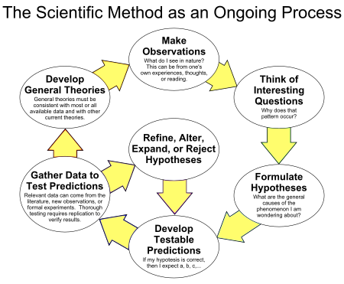
Ongoing Scientific Process

Slide 46
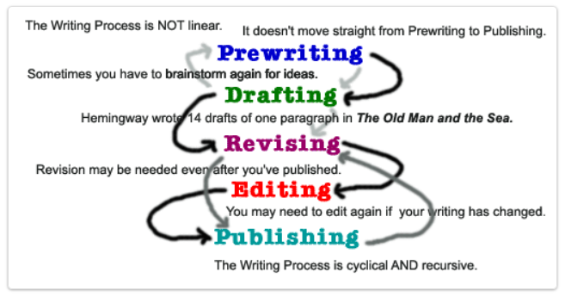
The Writing Process

Slide 47
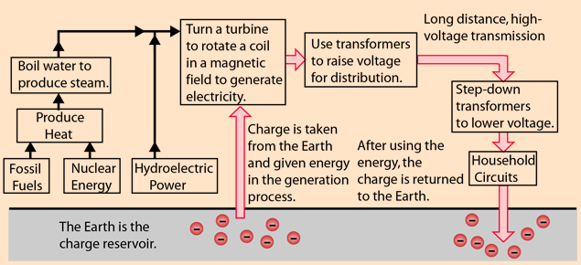
Q: What is this Process?
A: The Electricity Generation Process

Slide 48
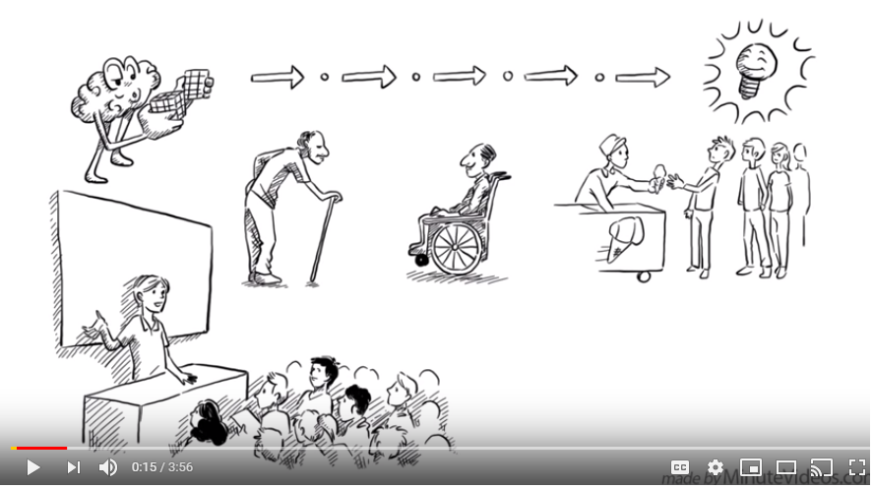
The Design Thinking Process
Watch the following video one time:
https://www.youtube.com/watch?v=_r0VX-aU_T8

Slide 49
Divide the Introduction into Chunks
Add ‘chunking’ to the ‘The Design Thinking Process’ Introduction
“Design thinking is a five-step process to come up with meaningful ideas that solve real problems for a particular group of people. The process is taught in top design and business schools around the world. It has brought many businesses lots of happy customers and helped entrepreneurs form all around the world to solve problems with innovative new solutions.”
https://www.youtube.com/watch?v=_r0VX-aU_T8

Slide 50
One possibility for Chunking
“Design thinking / is a five-step process / to come up with meaningful ideas / that solve real problems / for a particular / group / of people. / The process is taught / in top design and business schools / around the world. / It has brought many businesses / lots of happy customers / and helped entrepreneurs / from all around the world / to solve problems / with innovative / new / solutions.”
https://www.youtube.com/watch?v=_r0VX-aU_T8

Slide 51
Deliver the following with Chunking and eye contact
Read the first chunk silently to yourself; memorise it
Look at your partner and say each chunk from memory while making sustained eye contact with him/her (do not look at the screen or your paper)
(Remember to stress the syllables / words in red colour below)
Repeat this process until you have finished the paragraph
When finished, change roles with you partner
“Design thinking / is a five-step process / to come up with meaningful ideas / that solve real problems / for a particular / group / of people. / The process is taught / in top design and business schools / around the world. / It has brought many businesses / lots of happy customers / and helped entrepreneurs / from all around the world / to solve problems / with innovative / new / solutions.”
https://www.youtube.com/watch?v=_r0VX-aU_T8

Slide 52
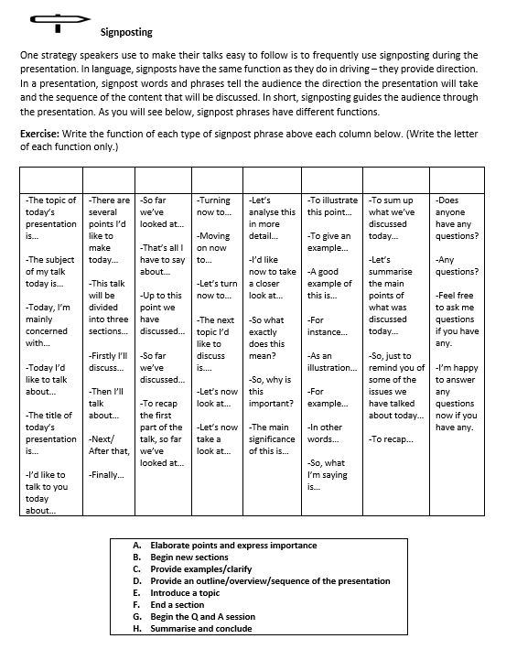
Write the function (A-H) of each Column

Slide 53

Prepare and Teach Your own Process Mini-Lesson
Prepare a 4-minute Process mini-lesson for a partner.
Be sure to:
Make notes of what you will say (not full sentences)
Organize your talk with a logical process structure
Decide if you will use active or passive voice
Remember to use signposting to introduce each step of the process
Make eye contact, smile, use natural hand gestures and chunking
Teach it to your partner with proper pronunciation, word stress, sentence stress, intonation
Change roles with your partner afterwards

Slide 54
SG8002 Assessment Instructions for Candidates
Before the Assessment:
You will be given hard copies of materials in Lesson 4 (today). Using those materials, you should prepare for a 5-minute teaching demonstration. Your lesson must be on those materials. Please do not write on or photocopy the materials and please return them to your tutor when you arrive to do your teaching lesson in Lesson 6.
You should prepare your teaching demonstration on your own and you may review any of the materials which was covered in the sessions of the course to help you, including explanation strategies, language for different functions, pronunciation, rhythm, stress, eye contact, natural hand gestures and body language, chunking, etc.
You may prepare one PowerPoint slide with no more than four main points and no more than 75 words in total on the slide.
You are strongly advised to practise and rehearse your teaching demonstration, but do not memorize (recite) it. Time your teaching demonstration, keeping to five minutes, so that you can deliver it naturally and still allow for a question or more from your tutor. Think of questions which your tutor may ask during the five minute teaching assessment and be ready to answer them.
During the Assessment:
Be on time. Your tutor will ask you what your topic is, confirm your name, and answer one or two other questions. When you start, introduce your topic in an interesting way and do your teaching demonstration. Your tutor may ask questions at any time. After the teaching demonstration, please leave the room immediately so that the next candidate may enter and begin her/his teaching demonstration.
After the Assessment:
After the teaching demonstrations are all finished, the tutor will assign either ‘P’ for Pass or ‘F’ for Fail. Those who pass will be registered in SG8001 and those who do not will need to pass SG8002 before enrolling in SG8001. Grades will be released at the end of the semester.
See the course booklet for a description of a ‘P’ and a description of an ‘F’.

Slide 55
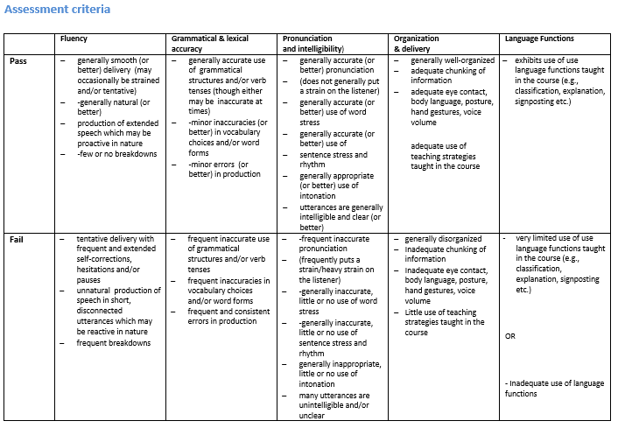

Slide 56

To Prepare For Your Assessment
Be sure to look up any words that are difficult for you to pronounce in:
Cambridge online dictionary, or…
Oxford online dictionary, or…
Macmillan online dictionary
…and learn how to pronounce them accurately, especially key words.
Pay attention to:
Accurate pronunciation of monophthongs, diphthongs and consonants
Syllables in each word that should be stressed/reduced
Important words in each sentence that should be stressed
Appropriate intonation at the end of sentences and questions
Use:
Signposting, chunking, appropriate voice volume, eye contact, natural hand gestures, appropriate speed…

Slide 57

homework
Do at least one hour of OPTIMUS work; refer to and complete the OPTIMUS homework reflection form on pp 34-36 in Course Booklet, Lesson 4. Submit this in Lesson 5. (Compulsory)
Begin preparing for your Final assessment in Lesson 6. Look up all words which are difficult for your to pronounce and check word stress.
Refer to the recommended on-line sites and apps from Lesson 1 for pronunciation and stress and do more practice.
Record or video yourself a few times teaching a simple concept with definition and classification from your discipline with the strategies you have learned today and last week. Critically analyze your recordings/videos and look for ways to improve them.

